Slide 1
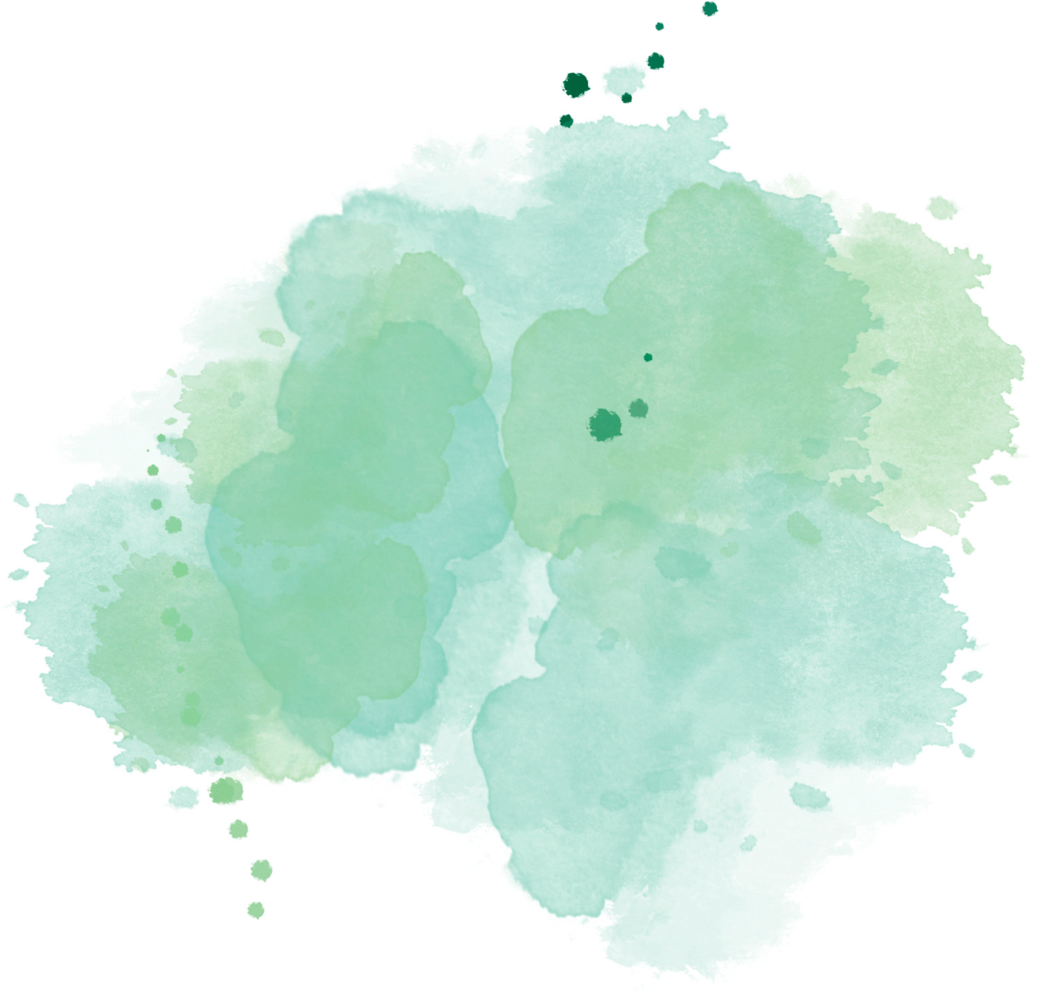


Universal Design Of Learning
Tamilarasi

Slide 2



What is UDL?
It is a culturally inclusive framework that maximize teaching and learning
It is based on scientific evidence of how humans learn

Slide 3
  Multiple means of engagement ( the WHY of learning)
  Multiple means of representation ( the WHAT of learning)
  Multiple means of actions and expressions( the HOW of learning)
Udl guidelines

Slide 4
Six elements of UDL
Ownership of students’ learning:
Teacher communicates the Learning Target and success criteria to the class.
Segway to the content.
Pre - assessment, Activate prior Knowledge.
Choice of materials
Videos, hand outs, graphic organizers, model problems, model work, rubric
Collaboration /group presentation
Supporting each other, learn from each other, social and communication skills
Self - assessment
Reflect and know where they stand
Exit ticket
Assess the success criteria for the lesson.

Slide 5
  Equity through Variability and diversity
  Rigorous learning goals with flexible means
  Flexibility and variability helps to overcome the barrier.
  No one size fits all
  No typical student
  Leveled playing field
  Students have options to achieve the learning goal
  Build self awareness to become an expert learner.
  Teacher is a facilitator
  Teacher does not run the show.
  Choose, do, review
UDL & Equitable Learning

Slide 6


TEACHING
ACCOMODATIONS
Traditional:
Focus on what is taught
Presentation of the material in one way for the entire class.
Typical student in mind
UDL
What is taught and how
Variety of ways
Many types of learners
Traditional:
Specific students( IEP, 504)
UDL
All students
Example audio book
Traditional versus UDL
PRESENTATION OF THE MATERIAL
Traditional:
The teacher teaches in one way for the whole class.
UDL
The teacher and the student collaborate to decide on the goal and choices of the materials to become an expert learner.

Slide 7
Traditional:
Fixed ( the teacher stands in the front and teaches the whole class at once)
UDL
Flexible ( small group, large group, individual seating, the teacher moves around the room)
CLASSROOM SETUP
ASSIGNMENT
Traditional versus UDL
Traditional:
There is only one way for students to show what they know.
UDL
Students have many options to show what they know.
GRADES
Traditional
To measure performance periodically
Periodic feedback on quizzes, tests, and projects.
UDL
To reinforce goals
Continuous feed back
Students reflect on their learning goals.
Grades feed into that reflection discussion

Slide 8


REFERENCES
https://www.cast.org/impact/universal-design-for-learning-udl
https://www.cultofpedagogy.com/udl-equity/
https://www.texthelp.com/resources/universal-design-for-learning/why-udl-is-a-valuable-approach/
https://www.understood.org/en/articles/the-difference-between-universal-design-for-learning-udl-and-traditional-education

